Slide 1


Premier University,Chittagong
BIDDING SYSTEM

Slide 2




MEET THE TEAM...
Ovi Das
Refatul Islam
Musrat Jahan Lija
Sajia Akter
ID:2104010202187
ID:2104010202188
ID:2104010202215
ID:2104010202217

Slide 3
OUTLINE
01
Introduction
02
Motivation
03
Features
04
Methodology
05
Result Analysis
06
Limitation & Future Work
07
Conclusion
08
Reference

Slide 4
INTRODUCTION
01
What is Bidding System?
02
Why Bidding System is important?
03
Laravel framework with User-friendly interface

Slide 5

MOTIVATION
01
02
03
04
Streamlining
User Experience
Transparency
Real-time

Slide 6

FEATURES
User-specific dashboard
01
Admin dashboard
02
Bid creation with admin approval
03
Bid participation
04
Profile updates
05
Secure authentication system
06

Slide 7
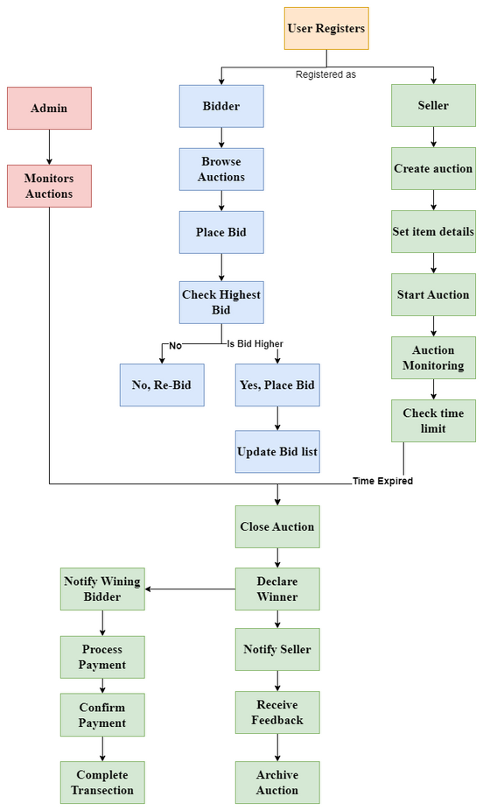
METHODOLOGY
Description Algorithm

Slide 8
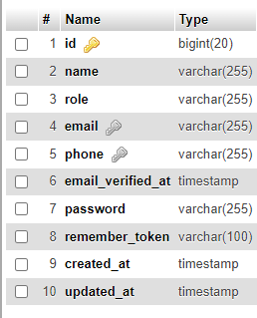
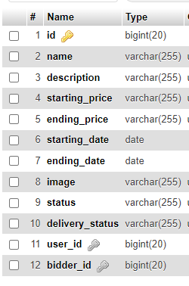
METHODOLOGY
Database
User
Bid

Slide 9
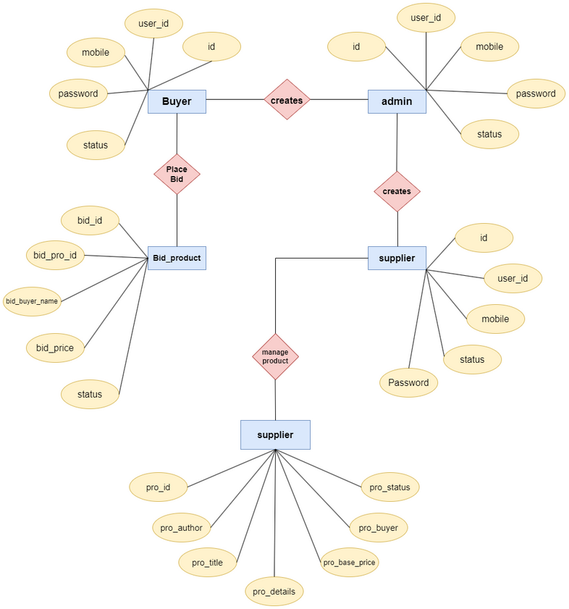
METHODOLOGY
ER Diagram

Slide 10
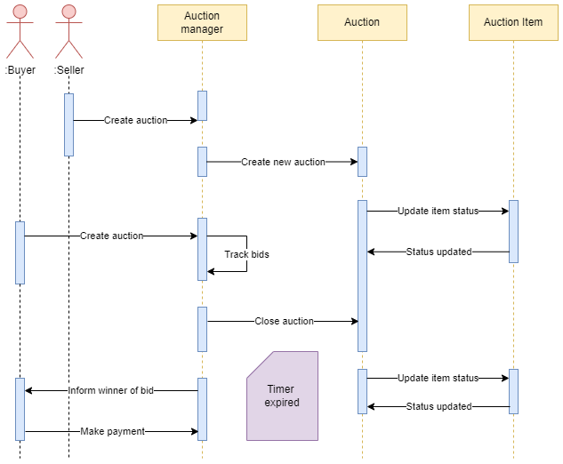
METHODOLOGY
Sequence Diagram

Slide 11
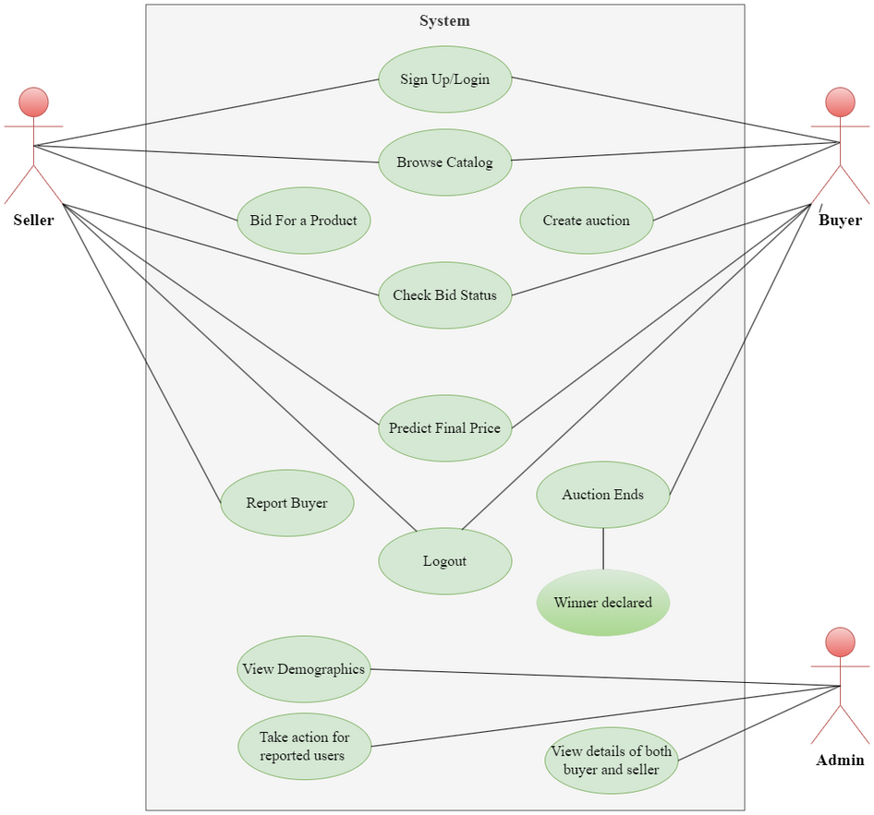
METHODOLOGY
Bidder
seller
Use Case Diagram

Slide 12
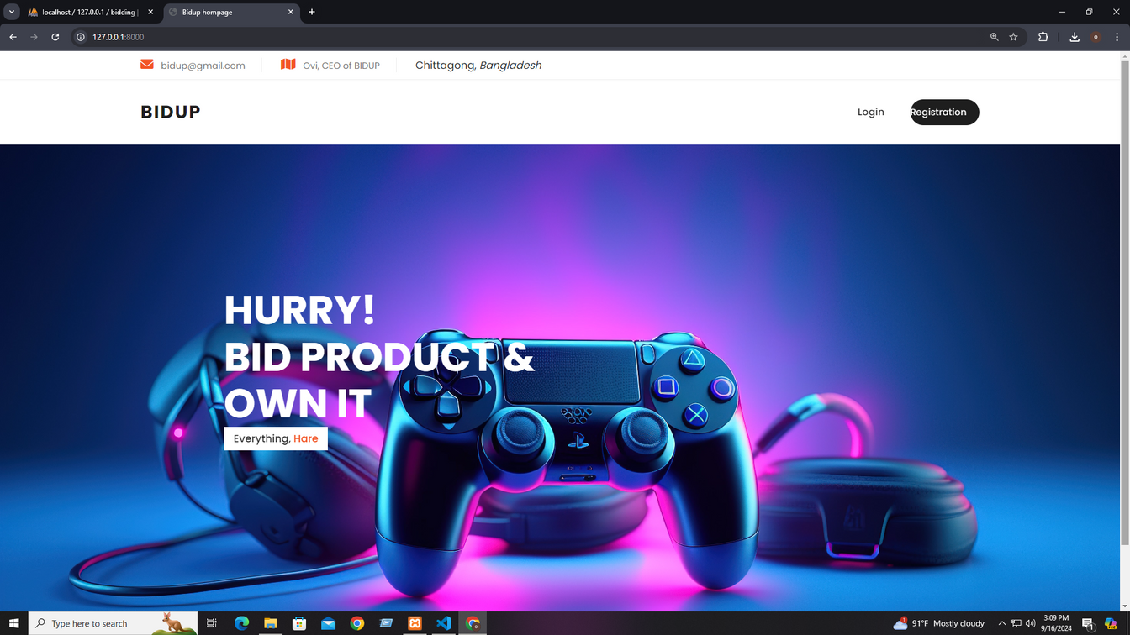
RESULT ANALYSIS
Home page

Slide 13
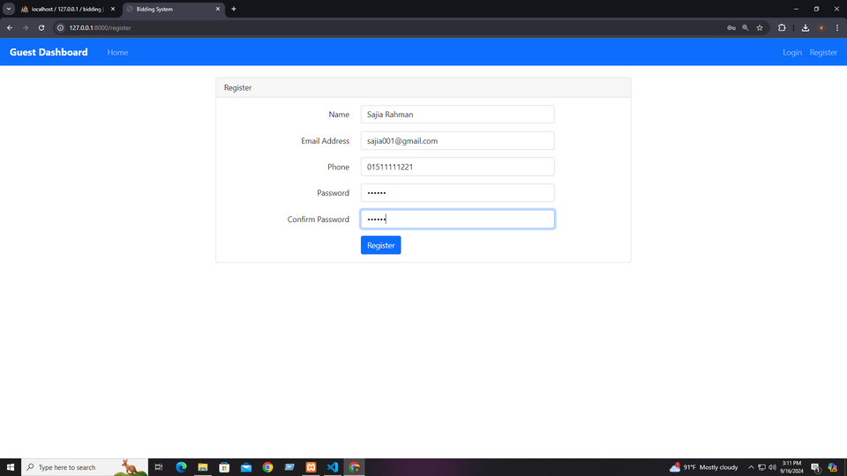
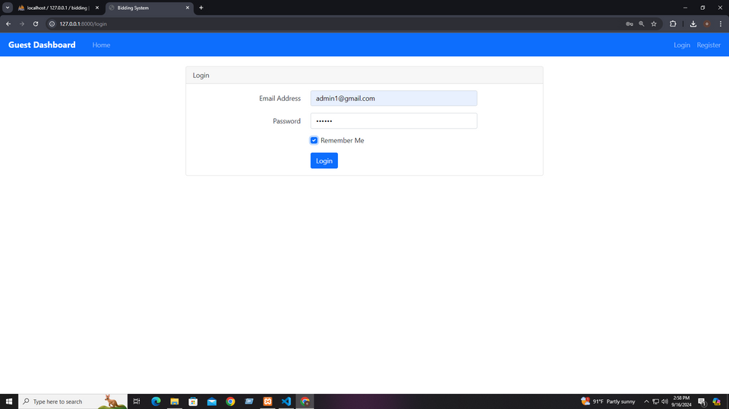
RESULT ANALYSIS
Registration & Login Dashboard
Registration page
Login page

Slide 14
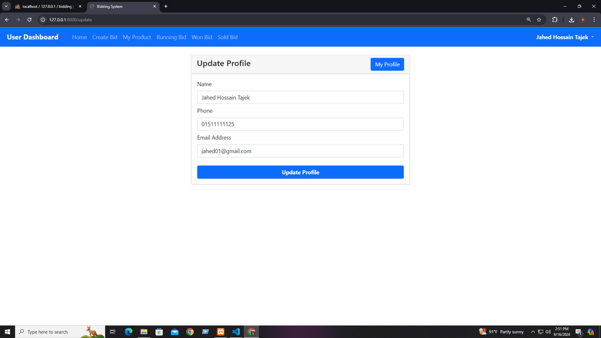
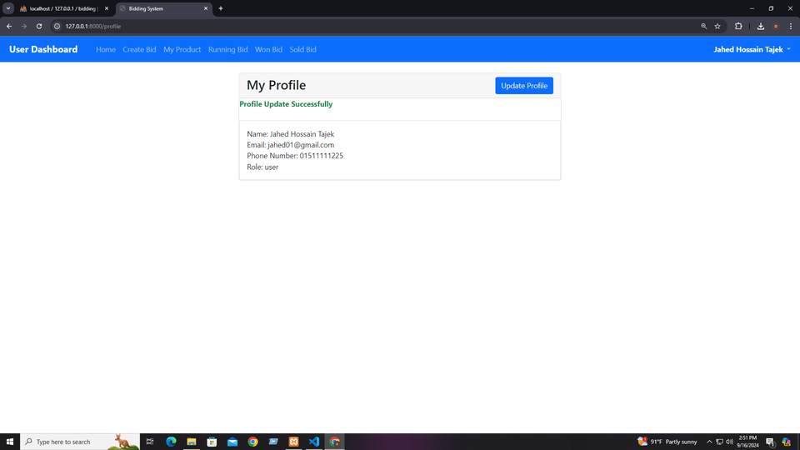
RESULT ANALYSIS
Profile Update Dashboard
Before Update
After Update

Slide 15
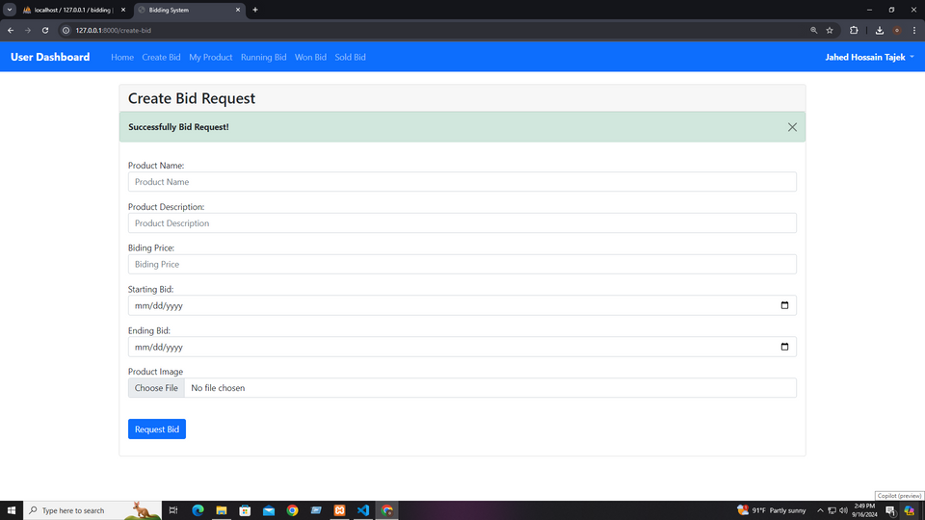
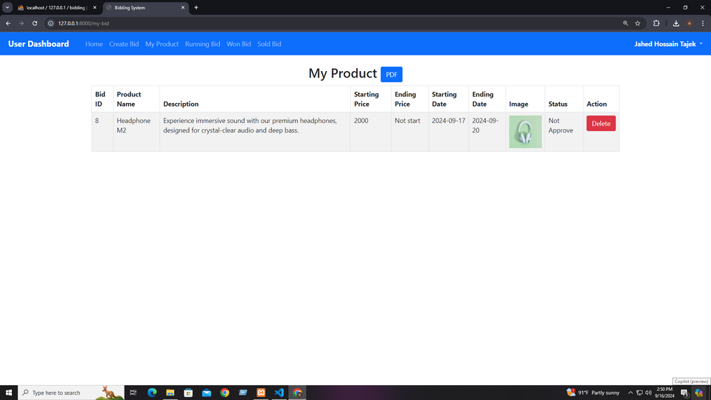
RESULT ANALYSIS
Seller Dashboard
Create Bid
Pending Bid

Slide 16
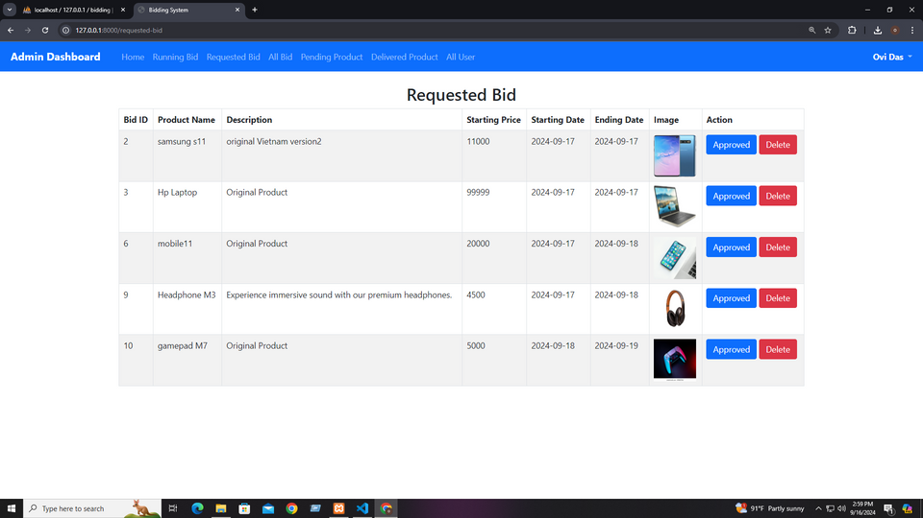
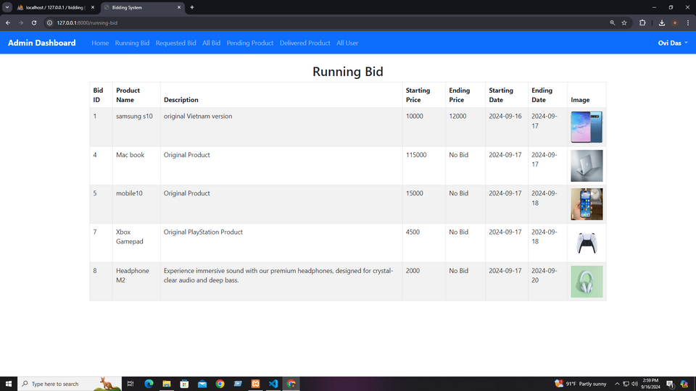
RESULT ANALYSIS
Admin Dashboard
Request Bid
Running Bid

Slide 17
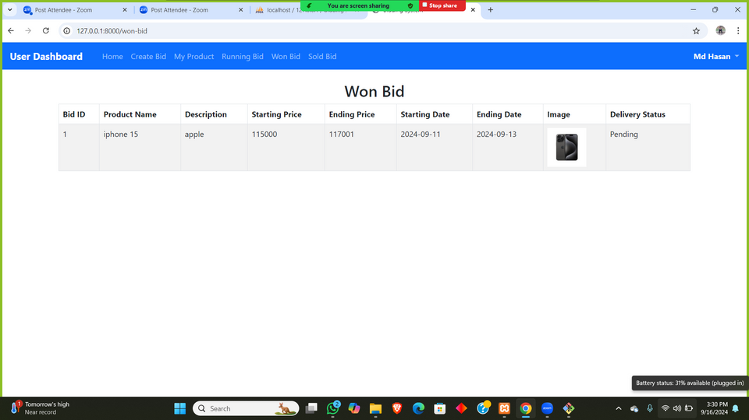
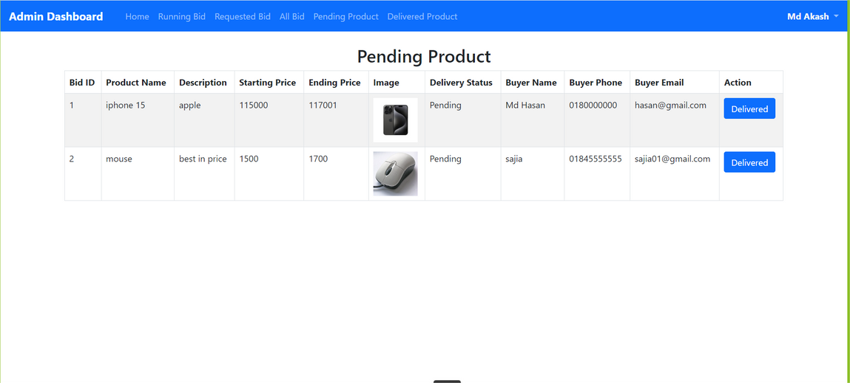
RESULT ANALYSIS
Won Bid Dashboard
Admin Approval won Bid

Slide 18
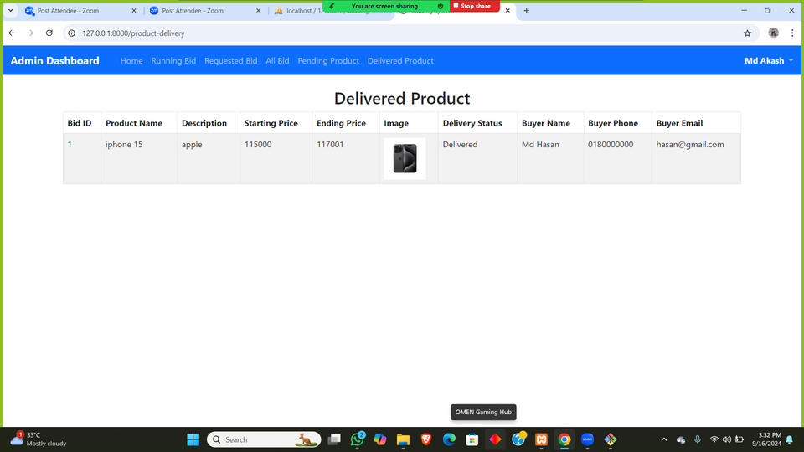
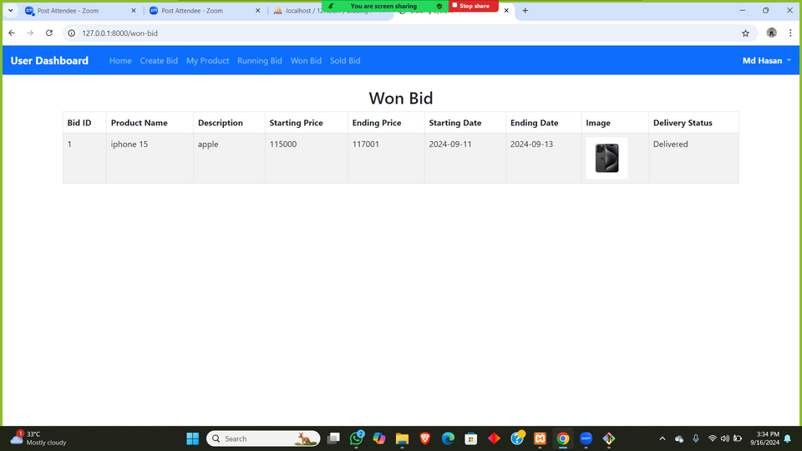
RESULT ANALYSIS
Delivered Product Dashboard
Bidder Received Product

Slide 19
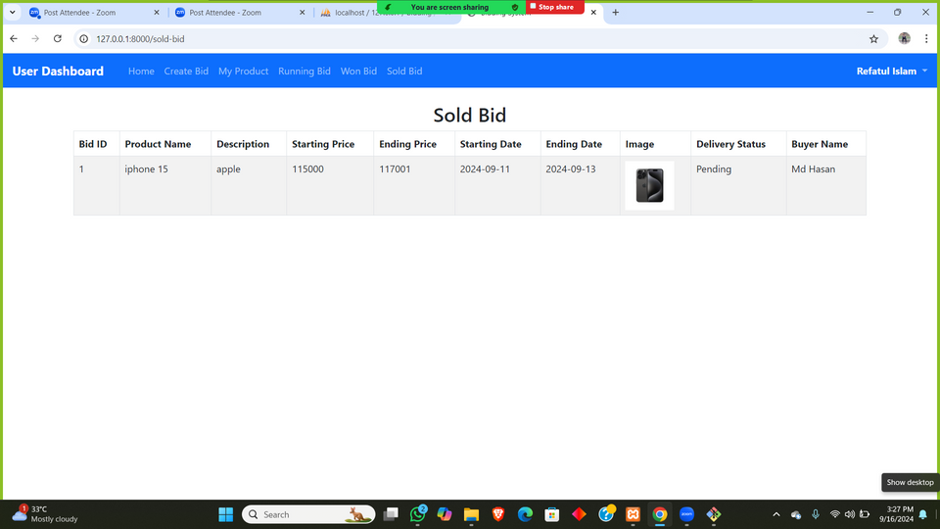
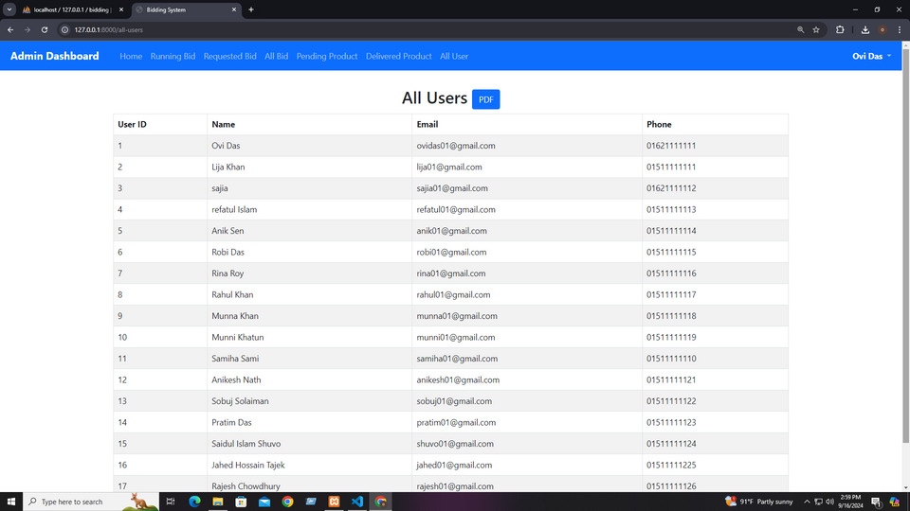
RESULT ANALYSIS
Sold Bid Dashboard
All User Dashboard

Slide 20
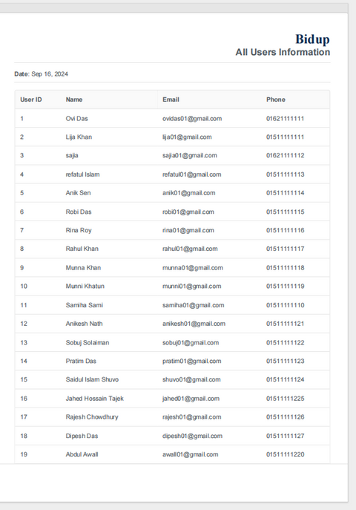
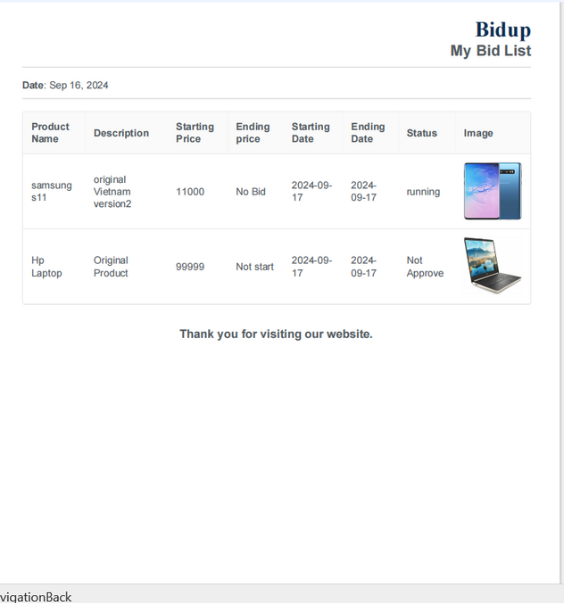
RESULT ANALYSIS
All user PDF
Bid PDF

Slide 21
LIMITATION
Current limitations of the system:
01
No Mobile application.
02
Potential scalability and performance issues.
Multi-omics Integration

Slide 22
FUTURE WORK
Future improvements:
01
Security Enhancements.
02
Develop a mobile version for broader accessibility.

Slide 23
CONCLUSION
A bidding system ensures a transparent and competitive process where bids are submitted, evaluated, and awarded based on clear criteria. This promotes fairness, efficiency, and the selection of the best value offer.

Slide 24
Do You Have Any Question??

Slide 25

Thank you...

